Slide 1
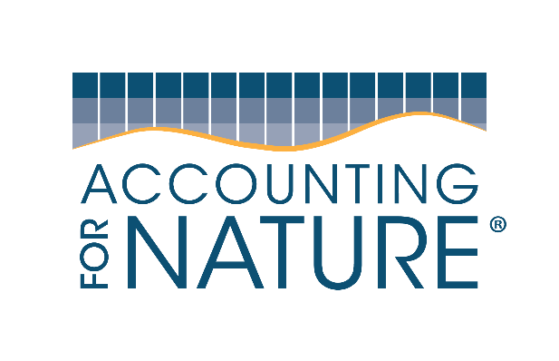
Welcome to this official
Accounting for Nature®
Training Workshop

Slide 2
Welcome
09:00-09:15

Slide 3
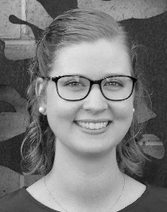
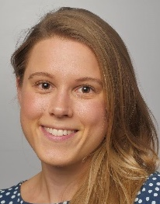
Who are we
CHRISSY ELMER (Science & Technology Program Manager) is a terrestrial ecologist with over eight years’ experience in ecological research, non-profit, local government, and private consulting. She has broad interests in terrestrial ecology, GIS and economics and holds a Bachelor of Science in Ecology and Plant Science and a Master of Environmental Management in Environmental and Natural Resource Economics. At Accounting for Nature she helps out with the development of New Accredited Methods and can provide technical advice and assistance on Environmental Accounts.
AMANDA HANSSON (Project Manager – Capacity building & Advisory) has more than nine years' experience in environmental research, natural resource management and the creation and delivery of educational material. She has project management experience in both the private and public sector and has provided consultancy services on national emission reduction projects. At Accounting for Nature Amanda works directly with Landcare, producer groups, natural resource management bodies and other organisations to originate Environmental Accounts at the project to regional scale.

Slide 4
Agenda for today
Time | Session
09:00-09:15 | Welcome & context
09:15-09:30 | What is Environmental Condition Accounting and how is it used
09:30-10:00 | The Accounting for Nature Framework and Accredited Methods
10:00-10:20 | Designing and registering an Environmental Account
10:20-10:40 | Morning tea
10:40-11:10 | Building an Environmental Account (Native Vegetation)
11:10-11:25 | Getting audited & Certified
11:25-11:40 | Fauna case study
11:40-11:50 | Soil case study
11:50-12:10 | Getting recognised as an AfN accredited expert and what are the next steps
12:10-12:50 | Lunch Break
12:50-15:00 | Implementing Methods in the field

Slide 5
Objectives of this workshop
Understand what and why for environmental/ natural capital accounting
Learn about the Accounting for Nature® Framework
The AfN 5-step approach for different assets
How to implement Methods in the field
Introduction to AfN’s Training & Accreditation platform

Slide 6
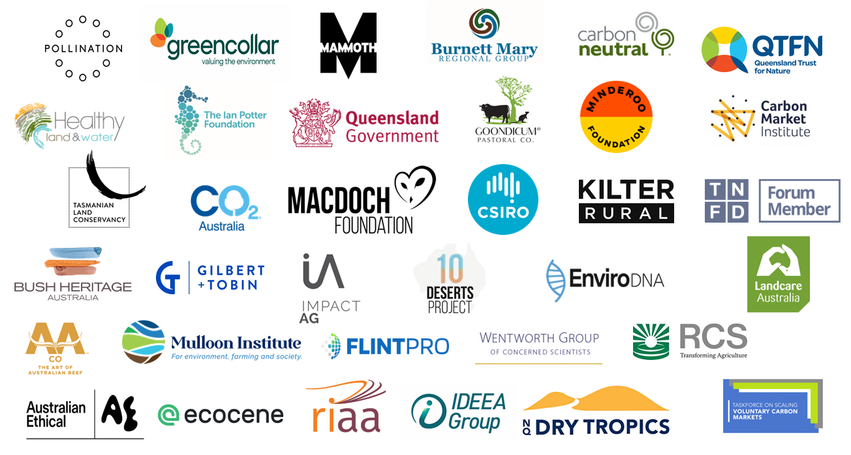
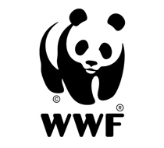
Partners and collaborators

Slide 7
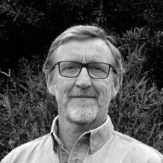
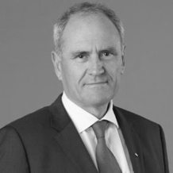
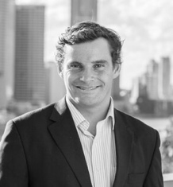
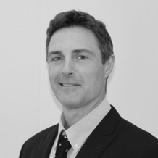
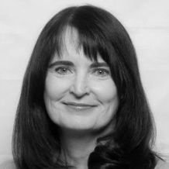
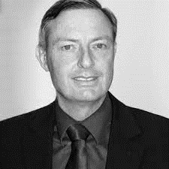
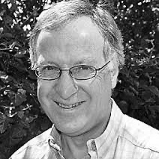
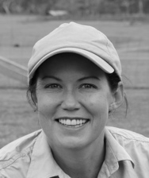
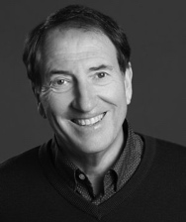
Board Members
Peter Cosier
Dr Ken Henry AC
DR ADRIAN WARD (CEO)
Cullen Gunn
Lynette Mayne AM
Peter is a Founding Member of the Wentworth Group of Concerned Scientists and a Director of the Tasmanian Land Conservancy. Peter was Policy Adviser to the Australian Environment Minister Robert Hill AC and was Deputy Director General for Science and Information in the NSW Government. He has a degree in Science, and a Postgraduate Diploma in Urban and Regional Planning. In 2017, he received a University of New England Distinguished Alumni Award.
Dr Henry AC is a former Chair of the National Australia Bank, a Non-Executive Director of ASX Ltd, the Cape York Partnership, and is Chairman of the Sir Roland Wilson Foundation at the Australian National University (ANU). Ken spent 28 years in senior policy advising roles in the Australian government, including 10 years as Australian Treasury Secretary from 2001 to 2011.
has more than 15 years’ experience (private and public sectors) in managing businesses and providing advice and training centered on environmental markets and natural capital in Australia and internationally. He is a former Australian Government Greenhouse & Energy Auditor who holds a Bachelor of Business, Post Graduate Certificate in Energy Economics and a PhD in Environmental Finance. He is a Member of the Australian Institute of Company Directors.
Cullen is the Executive Director and CEO of Kilter Rural. He has been overseeing its $400 million investment portfolio from the initial seed investment back in 2006. Since the early 1990s Cullen has dedicated his working life to advancing sustainable farmland, water and ecosystem management in Australia. He holds a Bachelor of Applied Science and a Postgraduate Diploma (Land Rehabilitation).
Lynette has a proven commercial track record as a CEO, Chair and Director, and is a successful entrepreneur who has established and run globally competitive businesses. She is Executive Chair of Richard Branson’s B Team Australasia; a Non-Executive Director of the Australian Infrastructure Financing Facility for the Pacific; and was formerly CEO of both Lendlease’s IT&T Investments Division and its Corporate Financial Services Division.
Peter Harper PSm
Max Kitchell
Nadia Campbell
DAVID SHELMERDINE
Peter has 38 years of experience with official statistics. He is the former Deputy Australian Statistician at the Australian Bureau of Statistics (including its environmental statistics program). Peter has extensive international experience in environmental-economic accounting, including as Chair of the UN’s Committee of Experts on Environmental-Economic Accounting. He has a degree in Economics.
Max has an Agricultural Science degree, is Chair of the Southern Blue Fin Tuna Management Advisory Committee and of the Small Pelagic Fisheries Scientific Panel, and Member of the Tasmanian Planning Appeals Tribunal. Max was previously Director of the National Oceans Office and Tasmanian Parks & Wildlife Service, Chair of NRM Regions Australia and board member of Greening Australia.
Nadia is the Director of Goondicum Pastoral Co. She has worked as a lawyer in private practice, for government owned corporations and as in-house legal counsel for the Commonwealth Bank of Australia. Nadia holds a Bachelor of Law (Hons) and a Bachelor of Commerce.
David is the Managing Director of Laradoc, a family-owned agricultural company. He has also served as Founding Director and Deputy Chair of ClimateWorks Australia for more than 16 years. He is chairman of the Melior Australian Impact Fund Advisory Council, a Director of Australian Desert Expeditions and served as a Director and President of the Geneva-based Gold Standard Foundation for 10 years.

Slide 8
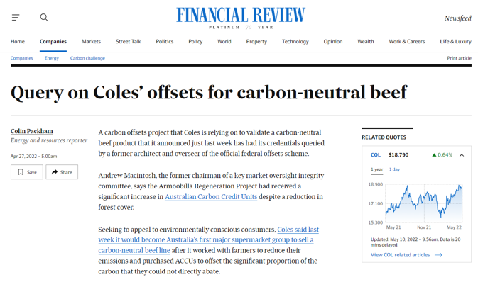
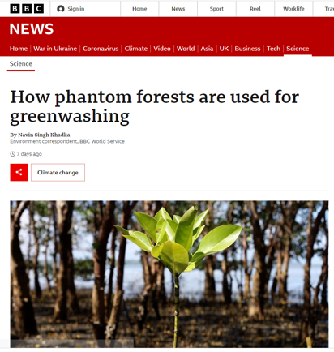
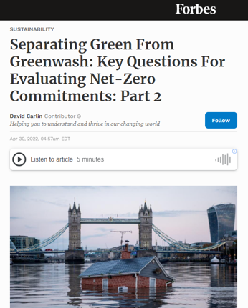
Integrity. The foundation of any credible market.
The Challenge: Rebuild trust
Carbon markets provide an opportunity to direct finance towards climate mitigation and nature-based solutions.
Recent developments in both voluntary and compliance “nature-based solution” carbon markets have been questioned for their integrity.
Likewise, more generally, corporate sustainability claims centring on nature have come under fire for greenwashing.
Lack of governance and unified standards around making green claims – such as “climate positive” and “nature positive” make it difficult for market participants to verify the integrity of carbon credits and green claims.
This is a risk, not only for brand reputation, but also for the entire credibility of carbon and natural capital markets.

Slide 9
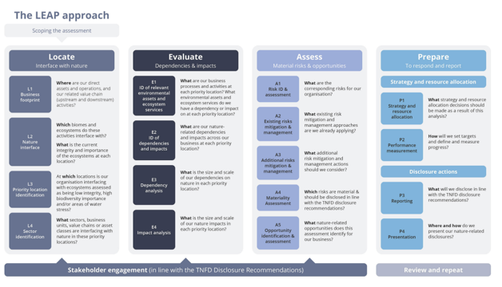
Nature-risk disclosure. Soon to be the new norm in corporate transparency.
Disclosure of “nature risk” in a company’s supply chain or investment portfolio is becoming the norm – just like was the case for climate change in the last few years.
This is demonstrated by the recent and strong interest in the taskforce for Nature-related Financial Disclosure (TNFD).
There are currently 350+ companies which are members of the TNFD forum. Collectively, the Members represent institutions with a combined market capitalisation of over US$3.1 trillion, over US$18.3 trillion in assets under management and a footprint in over 180 countries.
Accounting for Nature® environmental accounts, generated via EvA, fit neatly into the TNFD’s LEAP approach.
The TNFD is currently accepting pilot projects for global recognition.

Slide 10
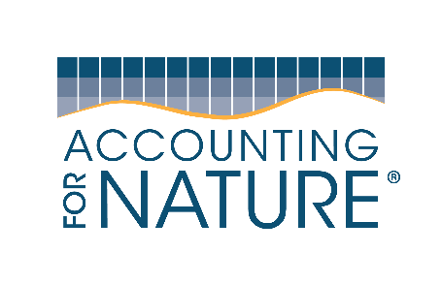
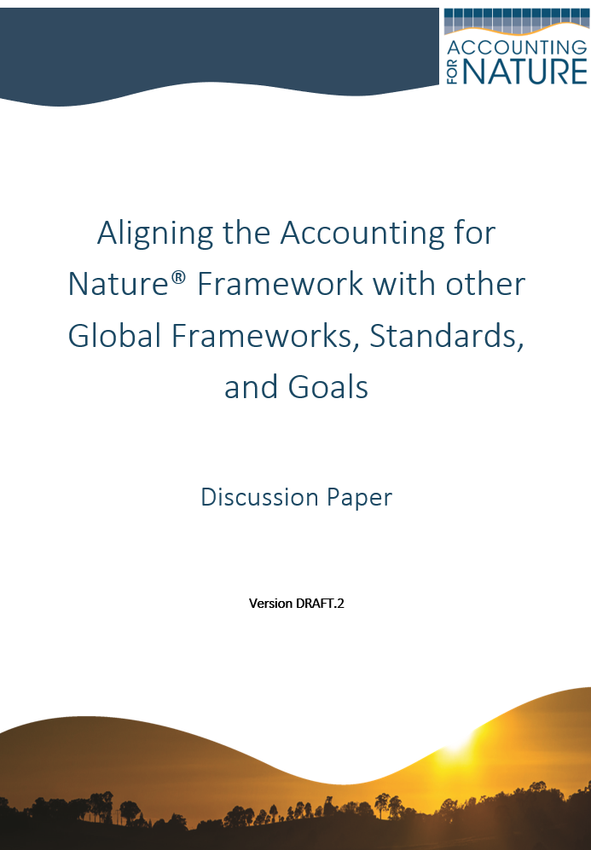
Alignment of AfN & Global Frameworks
Framework, Standard, Goals | Does AfN align?
Sustainable Development Goals | Yes
Convention on Biological Diversity | Yes
Global Goal for Nature | Yes
UN SEEA | Yes
BIOFIN | Yes
TNFD | Yes
Science Based Targets for Nature | Yes
Natural Capital Protocol | Yes
ISSB | Yes
SASB | Yes
GRI | Yes

Slide 11
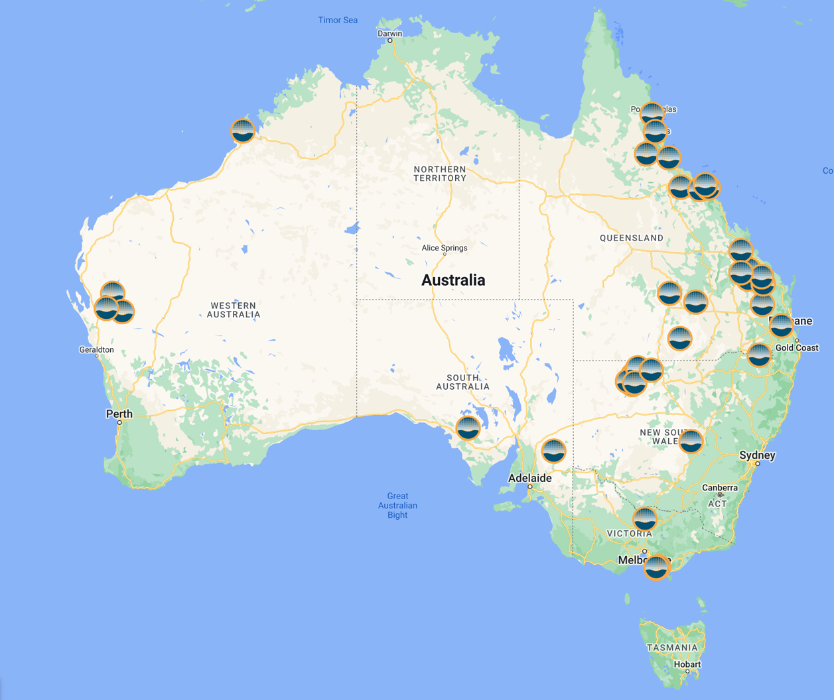
Who is using AfN?
Currently, 45 AfN Environmental Accounting projects underway, covering
+6 million ha.
The AfN Environmental Account Registry
https://www.accountingfornature.org/environmental-account-registry

Slide 12
Why are they using AfN?
CONFIDENTIAL
User | Purpose
Three largest carbon aggregators in Australia | Environmental co-benefit verification, claims, premium
Major international carbon project developer | Nature credits
Queensland Govt $500m Land Restoration Fund | Environmental co-benefit verification, funding payouts
Goondicum (small boutique grazier) | Evidencing environmental claims, selling into Europe
Kilter Rural (large impact agriculture fund) | Evidencing environmental claims. Impact investment DD
Burnett Mary Regional Group | Evidencing efficacy of government funding, private sector investment
Landcare groups / regen farmers | Various, mainly product labelling & grant applications
AACo (largest grazing company in Australia) | ESG & product claims, environmental co-benefit claims
International & major NGO | Evidencing koala population restoration / donor expenditure

Slide 13
What is Environmental Condition Accounting and how is it used
09:15-09:30

Slide 14
The global challenge
It is not possible to build a sustainable economy without measuring the change in environmental condition.
Governments, investors and consumers need simple yet scientifically credible environmental metrics to make informed decisions.
Currently, there are no such metrics.
Solving this global challenge will change the way we manage the economy and unlock billions of dollars for environmentally sustainable Investments.

Slide 15
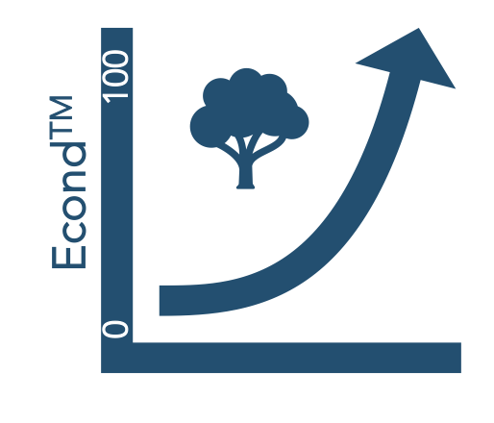
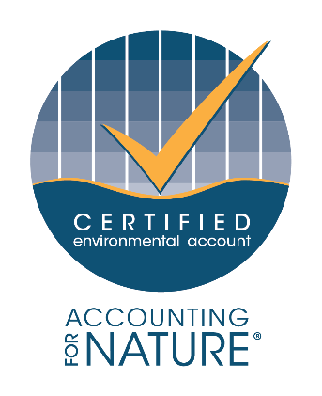
Our solution
Accounting for Nature® is a global environmental accounting framework.
It’s designed to guide business, investors, governments and landholders in building scientifically credible environmental accounts.
This allows for informed decisions when managing and investing in environmental assets, and when selling sustainable products and services.
Econd®
Accounting for Nature Ltd provides independent certification of
environmental accounts that meet the scientific requirements of the AfN Standard.

Slide 16
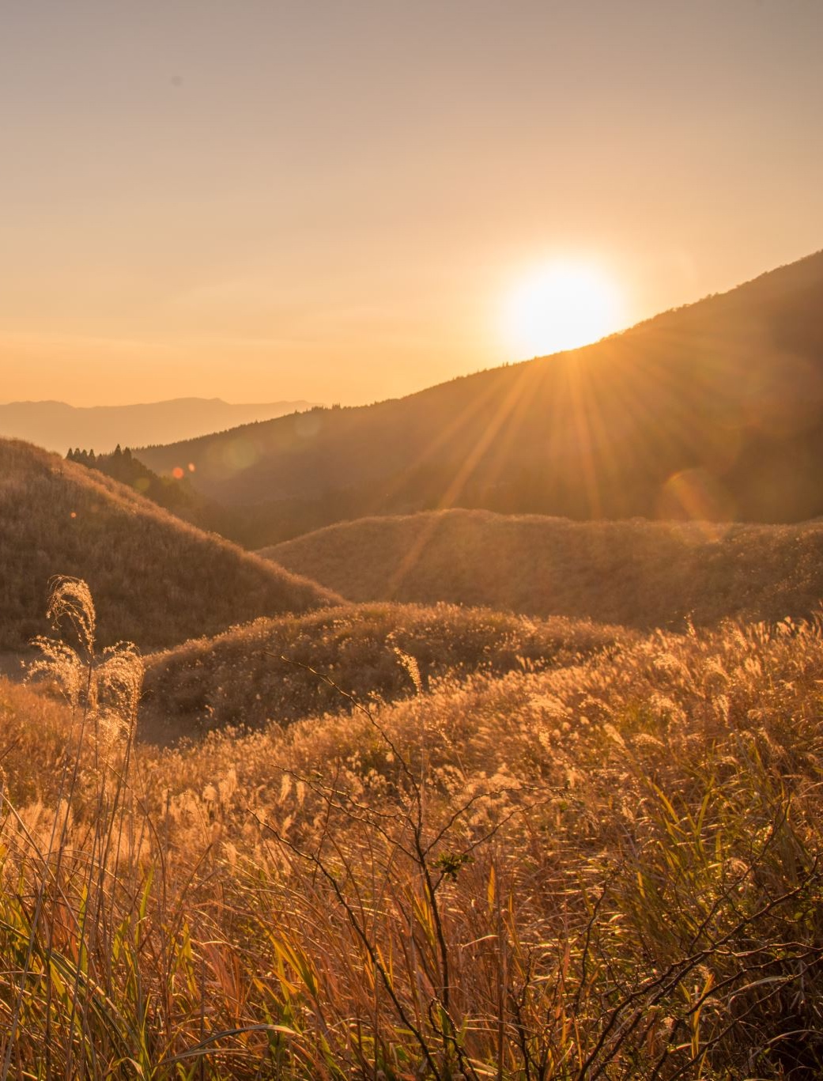
What does AfN do?
Certification of environmental accounts in accordance with the AfN Standard.
Accreditation of Scientific Measurement & Monitoring Methods for use under the Standard.
Training & accreditation of experts & auditors through face-to-face and online training and assessment and “AfN Expert Register”.
Coaching & advice, where we connect you with AfN Experts to assist interested parties in building their own accounts.
Developing an online environmental accounting system to cost-effectively help Proponents build their own Environmental Accounts with the click of a button.

Slide 17
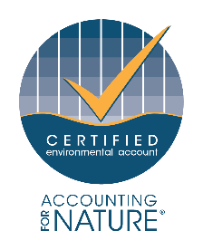
Why environmental account certification is important…
Farmers, landholders, investors, businesses and governments all need to prove their sustainability claims
They build Accounting for Nature® annual environmental accounts, which can be aligned to financial reporting
They then have their environmental accounts independently audited and certified by Accounting for Nature Ltd
Accounting for Nature® certification gives them confidence to publicly communicate their sustainability claims – be these focused on a project, product or investment.
This opens up new markets and funding opportunities.

Slide 18
… and the New markets & investment opportunities it can unlock
Governments, investors, consumers and landholders are ALL increasingly needing more reliable, standardised and credible environmental performance data to open new markets and efficiencies.
Use case | Voluntary carbon offsets + env. co-benefits (US$50b) | Landscape/ Marine green/blue bonds | Impact Investment for Real Assets (ag & forestry) | Performance-based Grants / subsidies | Certified sustainable food & fibre products | Market Indices (e.g. S&P)and insurance underwriting | Monitor & manage land more efficiently & sustainable
What AfN Standard can do | Due diligence & prioritisation |  |  |  |  |  | Resource allocation

Slide 19
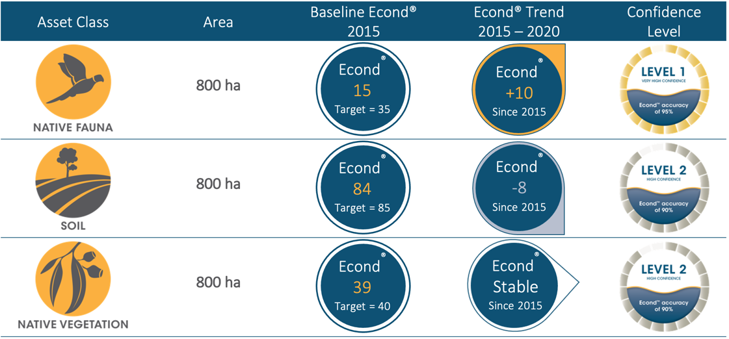
What is an environmental account?
Five year Econd® trend
Environmental Asset Sub-asset |  | Area (ha) | 2015 Econd® | 2020 Econd® | Net Econd® Change | Percent Econd® Change
Native Veg |  | 800 | 39 | 39 | 0 | 0%
 | Banksia Woodland | 200 | 21 | 22 | 1 | 5%
 | Heathy Dry Forest | 300 | 42 | 45 | 3 | 7%
 | Rocky Outcrop Shrubland | 200 | 38 | 32 | -6 | -16%
 | Red Gum Swamp | 100 | 64 | 72 | 8 | 13%
Soils |  | 800 | 84 | 76 | -8 | -10%
 | Vertosol | 800 | 84 | 76 | -8 | -10%
Woodland Birds |  | 800 | 15 | 25 | 10 | 67%

Slide 20
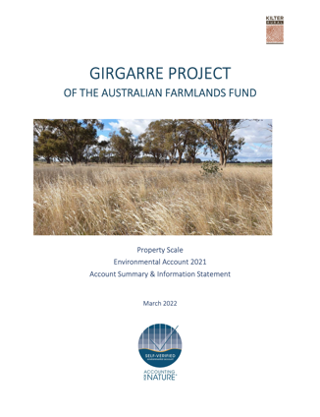
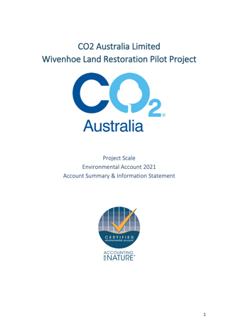
Information Statement
THE INFORMATION STATEMENT
An Information Statement is a public document that accompanies all AfN Environmental Accounts.
It includes:
An introduction to the account context, purpose and scope
A simple description of the process
A summary of the outcomes
Identification and acknowledgement of limitations
It provides complete transparency in an easy-to-understand format, which allow the market to understand exactly what was involved in creating the account.

Slide 21
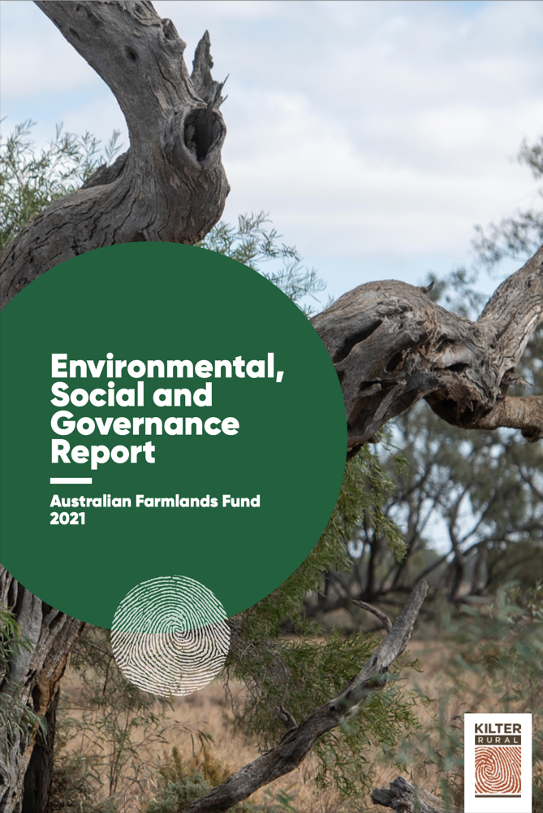
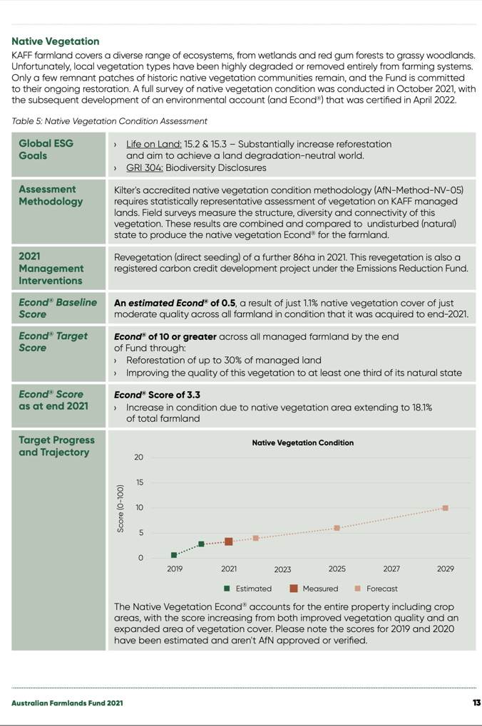
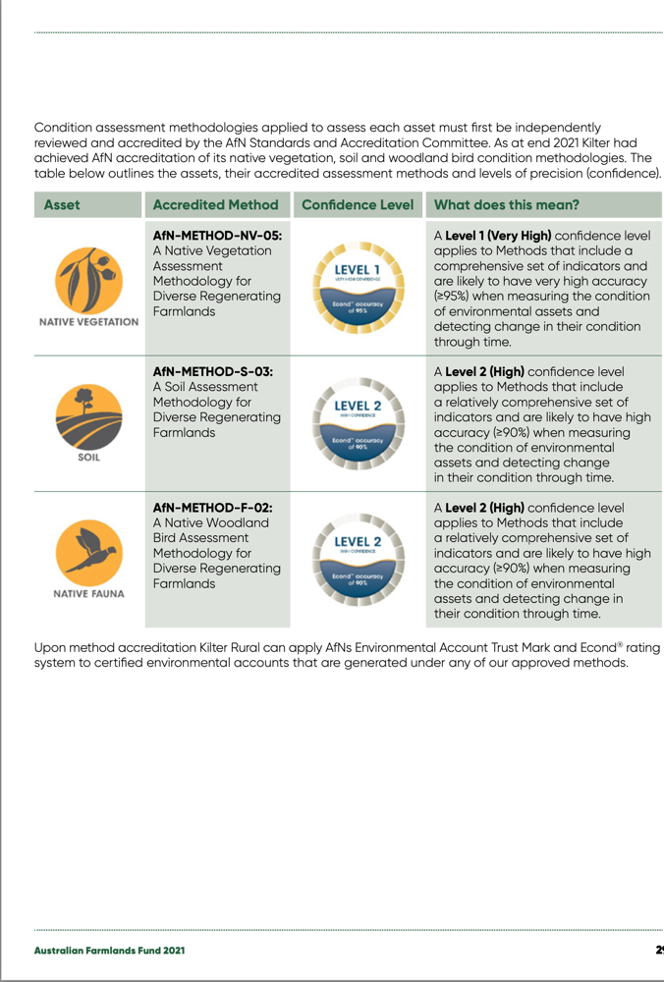
Supporting ESG reporting

Slide 22
The Accounting for Nature Framework and Accredited Methods
09:30-10:00

Slide 23
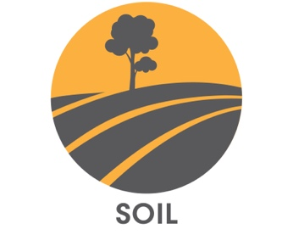
What environmental assets can you measure?
An Econd® can be generated for each of the below five environmental asset classes.
Certified Environmental Accounts can be linked with carbon or other environmental products to claim and verify environmental co-benefits.

Slide 24
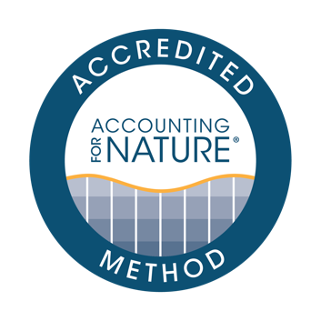
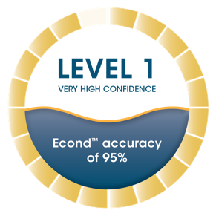
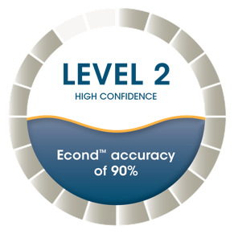
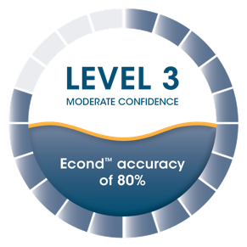
AfN ACCREDITED METHODS
AfN Accredited Methods provide the instructions on how to measure and calculate an Econd®.
Methods are developed:
For a specific purpose
For a specific environmental asset
At a particular confidence level
At a particular scale (local or regional) (regional vs local)
Method confidence levels are based on the indicators and how they are measured, and the sample size and design.
All AfN Accredited Methods must be reviewed and approved by the independent Science Accreditation Committee.
An Econd® is given the same Confidence Level as the Method used to generate it.

Slide 25
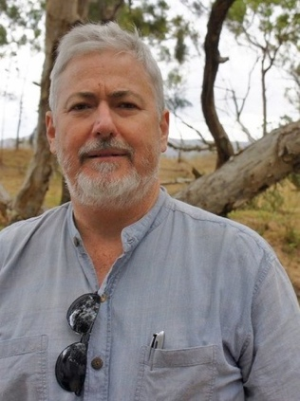
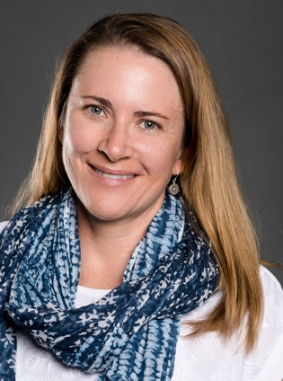
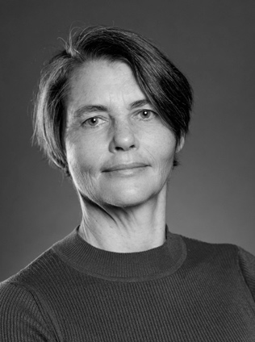
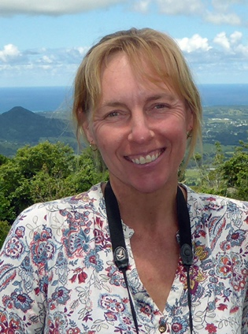
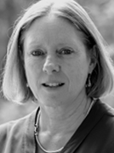
Science Accreditation Committee
Mike Grundy (Chair)
Adjunct Professor, Sydney Institute of Agriculture, The University of Sydney; Member, Wentworth Group of Concerned Scientists; Specialist Advisor, TERN
Specialty – soils.
Dr Rebecca Bartley
Research Scientist, CSIRO Land & Water.
Specialty – freshwater & estuaries.
Dr Suzanne Prober
Senior Principal Research Scientist, CSIRO Land & Water. Speciality – native vegetation.
Prof. Sarah Legge
Leader NESP Threatened Species Recovery Hub, Professor at Australian National University, Principal Research Fellow with the University of Queensland. Speciality – native fauna.
Prof. Fran Sheldon
Professor and Head of School, School of Environment and Science, in the Griffith Sciences Group at Griffith University and a Research Member in the Australian Rivers Institute Speciality – Rivers and Freshwater.

Slide 26
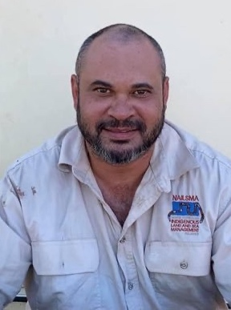
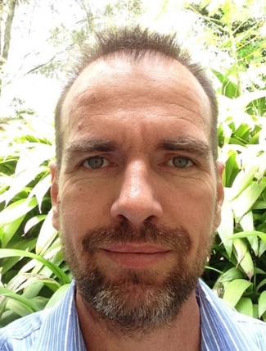
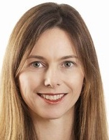
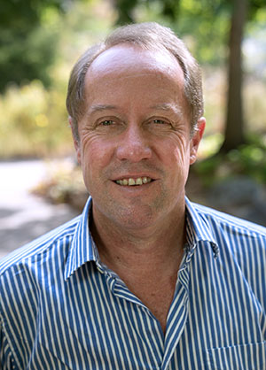
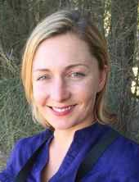
Technical Advisory Panel
Ricky Archer
CEO, Northern Australian Indigenous Land & Sea Management Alliance.
Dr Don Butler
Ilona Millar
Prof Hugh Possingham
Prof Martine Maron
Australian National University, former Principal Scientist to the Land Restoration Fund.
Head of Climate Change Practice, Gilbert & Tobin.
Chief Scientist of Queensland, former Chief Scientist of the Nature Conservancy. Professor at the University of Queensland.
Professor of Environmental Management and an ARC Future Fellow.

Slide 27
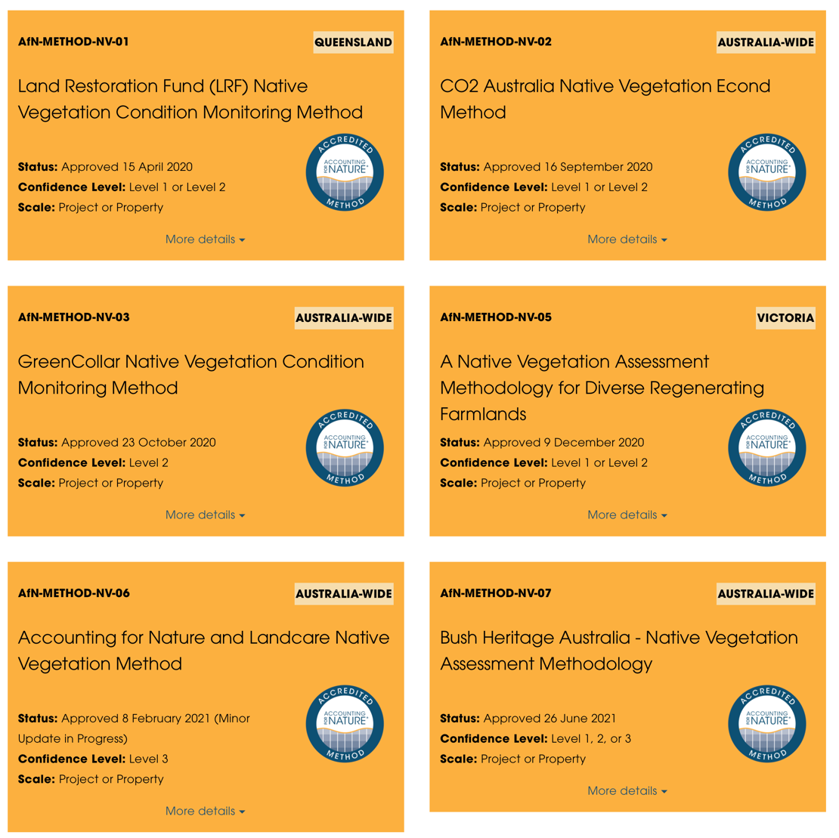
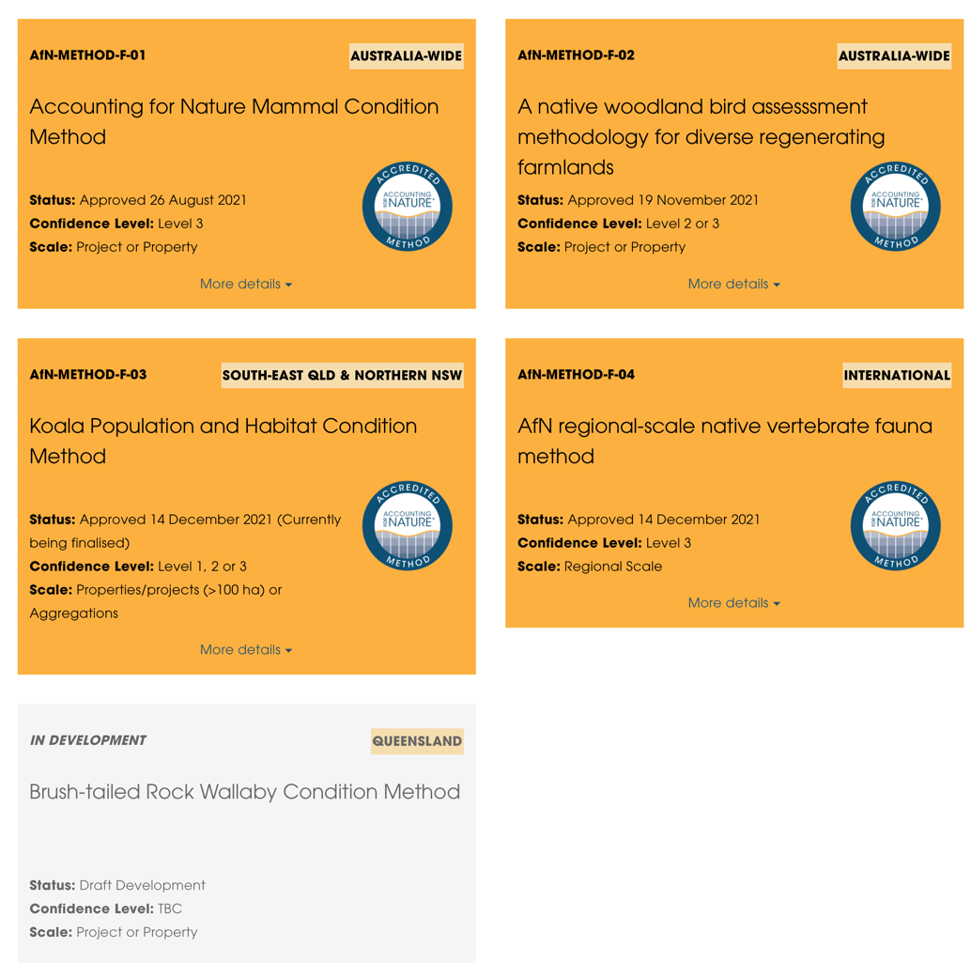
Select a Method

Slide 28
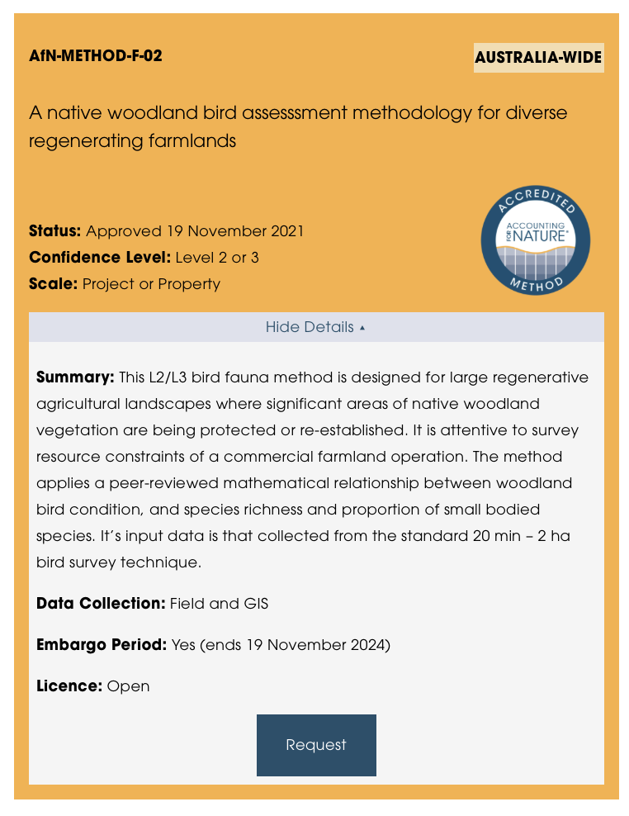
Selecting a Method – what to look for

Slide 29
The Econd® and Pcond

Slide 30
Core documents and key resources
1
AfN Certification Standard
Audit & Verification Rules
Claims Rules
Fee Schedule
Glossary & Key Terms
AfN Approved Methods (discussed previously)
2
3
4
5
6
The 5-Step webpage guides you through the process of designing, building and certifying your environmental Account. This webpage provides links to download all forms, documents and other resources to help you complete this process.

Slide 31
AfN Guideline Documents
Confidence Levels Guidelines
Guidelines for Pcond soil condition accounts
Guidelines for developing Native Vegetation Methods
Provisional Bird Guidelines
Guidelines for Reference Benchmarking
Guidelines for the hindcasting environmental condition
Guidelines for setting Condition Targets
Materiality guidelines
Guidelines for Integrating Traditional Environmental Knowledge into the AfN Framework
Guidelines for counterfactual analysis
Guidelines for linking carbon offset units & the Econd®
Visual asset style guide
1
2
3
4
5
6
7
8
9
10
11
12

Slide 32
Using Historic Data
If historic data is able to comply with an AfN Accredited Method
Calculate an Econd® and include it in the Certified Environmental Account
If historic data is not able to comply with an AfN Accredited Method
Use the information to provide some general context and background for the Account

Slide 33
Condition Targets
Describes the realistically attainable condition for a given asset
The ‘target condition’ might be the same as reference condition where the goal is to fully restore an asset to its original condition (for example in a nature reserve).
However, in the vast majority of Accounts, the target condition will be less than the reference condition, sometimes significantly.

Slide 34
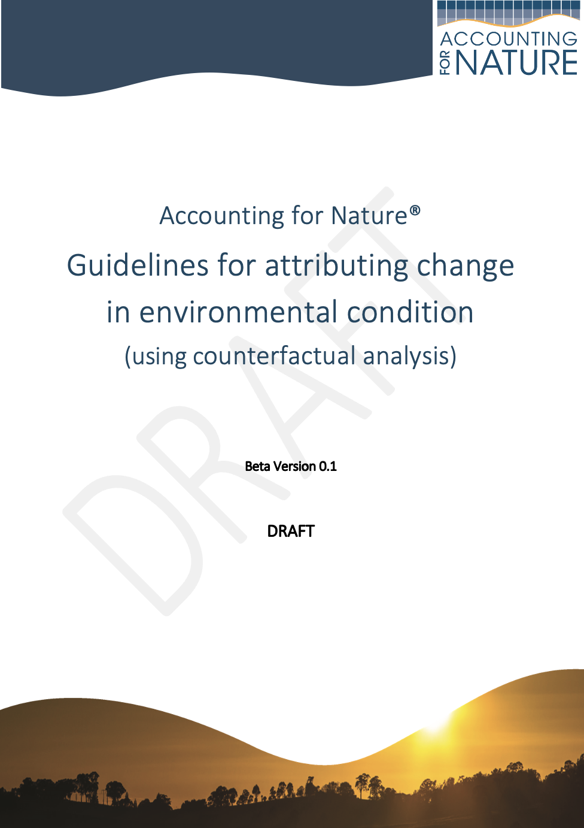
AfN Counterfactual Guidelines
Key Points
If a Proponent wants to make a public claim about the outcomes of a specific management impact or intervention, then they require counterfactual analysis to substantiate and have confidence in the claim.
Counterfactual Analysis can be used to underpin the additionality requirements of nature credits.
How to establish cause and effect
Physical control areas
Scenario modelling

Slide 35
AfN Environmental Account Certification process
1. DESIGN
Define the purpose & scope of the account Identify and prioritise environmental asset(s) Select existing or create new Method(s) Use Method(s) to plan stratification, indicators & Reference Benchmarks
2. REGISTER
Register project with Accounting for Nature Ltd
3. BUILD
Collect data Calculate Econd®
4. SUBMIT
Prepare account documentation, including Environmental Account Summary & Information Statement Obtain Technical Assessment or independent audit Set Condition Targets (optional)
Submit for “Self-Assessed” or “Certification” license approval
5. MAINTAIN
Maintain active project registration Submit Annual Certification Compliance Report Submit account and audit report (minimum every 5 years)
Repeat steps 3 - 5
Not for general distribution

Slide 36
Designing and Registering an Environmental Account
10:00-10:20

Slide 37
Environmental Account Design
1. DESIGN
Define the purpose & scope of the account Identify and prioritise environmental asset(s) Select existing or create new Method(s) Use Method(s) to plan stratification, indicators & Reference Benchmarks
2. REGISTER
Register project with Accounting for Nature Ltd
3. BUILD
Collect data Calculate Econd®
4. SUBMIT
Prepare account documentation, including Environmental Account Summary & Information Statement Obtain Technical Assessment or independent audit Set Condition Targets (optional)
Submit for “Self-Verified” or “Certified” license approval
5. MAINTAIN
Maintain active project registration Submit Annual Certification Compliance Report Submit account and audit report (minimum every 5 years)
Repeat steps 3 - 5

Slide 38
AfN for different purposes
Prior to commencing the creation of an environmental account, it is important to have a clearly defined purpose that addresses the following:
Who is the target audience of the environmental account?
What types of decisions will be informed by the account?
1

Slide 39
Scope
The purpose of an account will determine the scale and scope of the Environmental Account.
An account can measure the following scopes:
asset condition at a single point in time;
change in condition through time; and
impact of management activities on an asset’s condition.
1

Slide 40
Scale
1
The scale of the accounts should be determined based on the needs of the audience and the intended use of the account information.
Scale | Definition | Examples
Project | An area on which a discrete set of activities are undertaken. | Carbon farming project area, biodiversity offset site
Property | An area managed as a single unit for one or more purposes, including primary production or conservation. The boundaries of a property do not have to be contiguous. | Farm, fishery, conservation reserve
Portfolio | A collection of projects or properties under the management of a single entity. | Managed investment fund
Region | A larger area, typically owned and managed by multiple different entities for a range of purposes, or in which multiple entities have rights of access and use, that has definable characteristics (if not fixed boundaries). | Natural Resource Management region

Slide 41
Assets
What assets will you measure?
1
Our Materiality Guidelines help Proponents decide what is most important to measure by:
Clearly understanding and articulating why they are wanting to develop an Environmental Account, and,
Helping to identify what the priority and significant environmental assets are that should be measured in the Environmental Account, given the account purpose, and also differing perspectives of significance

Slide 42
Why would you want to develop an environmental account?
What assets are the most important to measure on your property?

Slide 43
Selecting a Method – what to look for
Remember – Accredited Experts can help you with this step

Slide 44
1 Stratification
Your account is stratified into assets, sub-assets and assessment units
Asset
Sub-assets
Broad vegetation types
Assessment units
Land use within vegetation type

Slide 45
1 Stratification

Slide 46
1 Select Environmental Indicators
The method will outline what indicators need to be measured
Indicator class | Indicator
Configuration | Indicator assessed with GIS - Context (%)
Composition | Indicators assessed by photos (optional field measures that are verified by photos): Non-native plant cover (%) Organic litter ground cover (%) Native perennial grass cover (%) Indicators assessed in the field: Native canopy height (if present) Native sub-canopy height (if present) Native canopy cover (%) Native sub-canopy cover (%) Native shrub cover (%)

Slide 47
1 Determine Reference Benchmarks
DEFINITION
A Reference Benchmark is a scientific estimate of the condition of an asset in its best possible state.
Photo courtesy of Burnett Mary Regional Group

Slide 48
1 Determine Reference Benchmarks
There are several approaches to determining Reference Benchmarks
Public condition record; Reference condition sites; Historical records; Robust model; and/or Expert opinion
Photo courtesy of Burnett Mary Regional Group

Slide 49
Environmental Account Design
1. DESIGN
Define the purpose & scope of the account Identify and prioritise environmental asset(s) Select existing or create new Method(s) Use Method(s) to plan stratification, indicators & Reference Benchmarks
2. REGISTER
Register project with Accounting for Nature Ltd
3. BUILD
Collect data Calculate Econd®
4. SUBMIT
Prepare account documentation, including Environmental Account Summary & Information Statement Obtain Technical Assessment or independent audit Set Condition Targets (optional)
Submit for “Self-Verified” or “Certified” license approval
5. MAINTAIN
Maintain active project registration Submit Annual Certification Compliance Report Submit account and audit report (minimum every 5 years)
Repeat steps 3 - 5

Slide 50
2 Register Project
When registering an Environmental Account you need to submit a Project Registration Form and Statement of Compliance & Good Faith
New project registration involves a once-off registration fee plus an annual fee for AfN to review and maintain the project in the Environmental Account Certification Registry.

Slide 51
What do I need to register?
Proponent and project details
Account purpose, scale and scope
Account stratification and sample plan
Method selection
Reference benchmarks

Slide 52
2 Register Project
Importantly, project Registration involves formally nominating the accredited Method(s) you will follow to prepare the environmental account.
Important!
Registration needs to occur before field data is collected. This is so that AfN can confirm that your field sampling plan is in accordance with the selected Method and account purpose.

Slide 53
Break
10:20 – 10:40

Slide 54
Building an Environmental Account (Native Vegetation)
10:40-11:10

Slide 55
Environmental Account Design
1. DESIGN
Define the purpose & scope of the account Identify and prioritise environmental asset(s) Select existing or create new Method(s) Use Method(s) to plan stratification, indicators & Reference Benchmarks
2. REGISTER
Register project with Accounting for Nature Ltd
3. BUILD
Collect data Calculate Econd®
4. SUBMIT
Prepare account documentation, including Environmental Account Summary & Information Statement Obtain Technical Assessment or independent audit Set Condition Targets (optional)
Submit for “Self-Verified” or “Certified” license approval
5. MAINTAIN
Maintain active project registration Submit Annual Certification Compliance Report Submit account and audit report (minimum every 5 years)
Repeat steps 3 - 5

Slide 56
3 Collect data
Every Method will have a different approach to collecting environmental condition data.
The Method will tell you what approach to use to obtain a measure for each indicator.
The method will guide you through:
The number of sample sites required
How to select sample sites
How to mark sample locations
How to determine what time of year to sample
If data needs to be analysed using desktop and remote sensing analysis
If samples need to be sent to a lab (if so, it will outline what tests are required)

Slide 57
Sampling methods for Native Vegetation
Indicator | Measure | Method | Source
Non-native plant cover | Non-native plant cover (Braun- Blanquet Cover Score) | ~ 10 m quadrat Braun-Blanquet | Field measure (depending on skill of assessor) verified by photos Or Average of two canopy photos supplemented by average of two landscape and ground photos
Cover | Canopy cover (%) | 30 m Step-count (Appendix D) | Field measure
 | Sub-canopy cover (%) | 30 m Step-count (Appendix D) | Field measure
 | Shrub cover (%) | 30 m Step-count (Appendix D) | Field measure
 | Organic litter ground cover (%) | ~ 1 m quadrat estimate | Field measure (depending on skill of assessor) verified by photos Or Average of two ground photos
 | Native perennial grass cover (%) | ~ 1 m quadrat estimate | Field measure (depending on skill of assessor) verified by photos Or Average of two ground photos
Height | Canopy (m) | Estimate (Appendix D) | Field measure
 | Sub-canopy (m) | Estimate (Appendix D) | Field measure

Slide 58
The native vegetation method will require the establishment of permanent monitoring sites

Slide 59
Sampling methods for Native Vegetation
Tree-height can be measured using stick or clinometer method by measuring the height of one representative average height tree

Slide 60
Sampling methods for Native Vegetation
Step 30 steps and record at each step if you are under canopy or sub-canopy

Slide 61
Sampling methods for Native Vegetation
Estimate the amount of organic litter cover and native perennial grass cover within a 1m quadrant to the nearest 5 or 10%.

Slide 62
3 Collect data
Data needs to be recorded in the field. The method will provide you with a templates of how to record this data.
Assessment unit
Photos IDs | North Canopy Photo
 | North Landscape Photo
 | North Groundcover Photo
 | South Canopy Photo
 | South Landscape Photo
 | South Groundcover Photo
Reference Vegetation Type
Area of assessment unit

Slide 63
3 Calculate Indicator Condition Scores
Indicator Condition Score
0
100
System function is absent
Reference Benchmark
Photo courtesy of Green Collar

Slide 64
3 Calculate Indicator Condition Scores (ICS)
The first step in calculating an Econd® is to calculate the Indicator Condition Score (ICS)
The ICS represents the difference in condition between your asset and its ideal condition. This score is calculated for each assessment unit.

Slide 65
Below are some examples of how to calculate ICS for various native vegetation indicators. Methods will provide you with the relevant formulas.
Non-native plant cover | =IF(OBS=5, 0, IF(OBS=4, 10, IF(OBS=3, 20, IF(OBS=2, 50, IF(OBS=1, 75, 0)))))
Canopy cover | =IF(REF=0,“NA”,IF((OBS/REF)<=0.49,200*(OBS/REF),IF((OBS/REF)<=1.5,100,IF((OBS/REF)<=2,- 40*(OBS/REF)+140,60))))
Sub-Canopy cover | =IF(REF=0,“NA”,IF((OBS/REF)<=0.49,200*(OBS/REF),IF((OBS/REF)<=1.5,100,IF((OBS/REF)<=2,- 40*(OBS/REF)+140,60))))
Shrub cover | For Woody Ecosystems: =IF(REF=0,“NA”,IF((OBS/REF)<=0.1,0,IF((OBS/REF)<=0.49,200*(OBS/REF),IF((OBS/REF)<=2,100, IF((OBS/REF)<=2.5,-40*(OBS/REF)+160,60)))))
 | For Grasslands: =IF(REF=0,((IF(OBS=0,100,IF((OBS/1)<=0.1,0,IF((OBS/1)<=0.49,200*(OBS/1),IF((OBS/1)<=2,100 ,IF((OBS/1)<=2.5,-40*(OBS/1)+160,60))))), IF((OBS/REF)<=0.1,0,IF((OBS/REF)<=0.49,200*(OBS/REF),IF((OBS/REF)<=2,100,IF((OBS/REF)<= 2.5,-40*(OBS/REF)+160,60)))))
Litter cover | =IF(REF=0,“NA”,IF(OBS/REF<=0.1,0,IF(OBS/REF<=0.5,250*(OBS/REF)- 25,IF(OBS/REF<=2,100,IF(OBS/REF<=2.5,-80*(OBS/REF)+260,60)))))
Native perennial grass cover | =IF(REF=0,“NA”,IF((OBS/REF)<1,(OBS/REF)*100,100))
Canopy height | =IF(REF=0,“NA”,IF((OBS/REF)<0.1,0,IF((OBS/REF)<0.19,8,IF((OBS/REF)<0.29,25,IF((OBS/REF)<0.39,41,IF((OBS/REF)<0.49,58,IF((OBS/REF)<0.59,76,IF((OBS/REF)<=0.69,41,100))))))))
Sub-canopy height | =IF(REF=0,“NA”,IF((OBS/REF)<0.1,0,IF((OBS/REF)<0.19,8,IF((OBS/REF)<0.29,25,IF((OBS/REF)<0.39,41,IF((OBS/REF)<0.49,58,IF((OBS/REF)<0.59,76,IF((OBS/REF)<=0.69,41,100))))))))
OBS = Observed condition
REF = Reference condition

Slide 66
Relationship between measure as a % of benchmark and ICS

Slide 67
The indicator condition score (ICS) is calculated for each indicator before it is aggregated to an Econd®
Assessment unit | Indicator |  | Reference Benchmark Measurement | Average measure | Indicator Condition Score (ICS)
RE 11.5.1 - Woodland restoration | Configuration - site context (%) |  | 100.0 | 91.8 | 91.8
 | Composition | Tree canopy height (m) | 20.0 | 14.6 | 100.0 | 68.9
 |  | Sub-canopy height (m) | 9.0 | 6.5 | 100.0
 |  | Tree canopy cover (%) | 25.0 | 10.0 | 80.0
 |  | Sub-canopy cover (%) | 20.0 | 6.4 | 64.0
 |  | Native shrub cover (%) | 6.0 | 55.0 | 60.0
 |  | Non-native plant cover (BB) | 0.0 | 3.0 | 20.0
 |  | Native perennial grass cover (%) | 23.0 | 16.0 | 69.6
 |  | Litter cover (%) | 45.0 | 26.0 | 57.8
The ICS for for all composition indicators are averaged, meaning you will have one value each for Configuration and Composition for every assessment unit.

Slide 68
3 Calculate Econd® indices
Calculating the property wide Econd® involves two broad steps:
First, an Econd® index must be calculated for each assessment unit by aggregating the ICSs.
Next, the Econd® for native vegetation at the property scale is calculated as an area-weighted average

Slide 69
1. First, an Econd® index must be calculated for each assessment unit by aggregating the ICSs.
Assessment unit | Indicator |  | Reference Benchmark Measurement | Average measure | Indicator Condition Score (ICS) |  | Assessment unit Econd®
RE 11.5.1 - Woodland restoration | Configuration - site context (%) |  | 100.0 | 91.8 | 91.8 |  | 74.6
 | Composition | Tree canopy height (m) | 20.0 | 14.6 | 100.0 | 68.9
 |  | Sub-canopy height (m) | 9.0 | 6.5 | 100.0
 |  | Tree canopy cover (%) | 25.0 | 10.0 | 80.0
 |  | Sub-canopy cover (%) | 20.0 | 6.4 | 64.0
 |  | Native shrub cover (%) | 6.0 | 55.0 | 60.0
 |  | Non-native plant cover (BB) | 0.0 | 3.0 | 20.0
 |  | Native perennial grass cover (%) | 23.0 | 16.0 | 69.6
 |  | Litter cover (%) | 45.0 | 26.0 | 57.8
Econd_{(15.1.1 Woodland restoration)} | = | (Configuration x 0.25) | + | Composition x 0.75)
74.6 | = | (91.8 x 0.25) | + | (68.9 x 0.75)

Slide 70
2. Next, the Econd® for native vegetation at the property scale is calculated as an area-weighted average.
This is done in two steps if there are multiple assessment units within one sub-asset (for example, if you have multiple land-uses occurring within one ecosystem type)
Sub-asset | Assessment unit | Assessment unit Econd® | Relative size of assessment unit compared to sub-asset area | Sub-asset Econd®
Regional Ecosystem 11.5.1 | RE 11.5.1 - Woodland restoration | 74.6 | 3% | 39.7
 | RE 11.5.1 - Protected woodland | 85.4 | 43%
 | RE 11.5.1 - Poultry farm | 1.3 | 2%
 | RE 11.5.1 - Grazing | 0.9 | 52%
Sub-asset Econd® is calculated as the sum of the area weighted assessment unit Econd®
39.69 = (74.6 x 0.03) + (85.4 x 0.43) + (1.3 x 0.2) + (0.9 x 0.52)

Slide 71
Once sub-asset Econd® have been calculated for all sub-assets this can be aggregated into a property wide Econd® for the asset
Sub-asset | Sub-asset Econd® | Relative size of sub-asset compared to account area | Econd®
Regional Ecosystem 11.5.1 | 39.7 | 21% | 44.5
Regional Ecosystem 11.3.2 | 34.8 | 37%
Regional Ecosystem 12.3.19 | 7.9 | 8%
Regional Ecosystem 12.3.11 | 64.8 | 34%
Asset Econd® is calculated by summing the area weighted sub-asset Econd® scores
44.51 = (42.7 x 0.21) + (34.8 x 0.37) + (7.9 x 0.08) + (64.8 x 0.34)

Slide 72
Questions?

Slide 73
Getting Audited and Certified
11:10-11:25

Slide 74
Environmental Account Design
1. DESIGN
Define the purpose & scope of the account Identify and prioritise environmental asset(s) Select existing or create new Method(s) Use Method(s) to plan stratification, indicators & Reference Benchmarks
2. REGISTER
Register project with Accounting for Nature Ltd
3. BUILD
Collect data Calculate Econd®
4. SUBMIT
Prepare account documentation, including Environmental Account Summary & Information Statement Obtain Technical Assessment or independent audit Set Condition Targets (optional)
Submit for “Self-Verified” or “Certified” license approval
5. MAINTAIN
Maintain active project registration Submit Annual Certification Compliance Report Submit account and audit report (minimum every 5 years)
Repeat steps 3 - 5

Slide 75
What do I need to become certified?
Environmental Account
Information Statement
Verification Report
Statement of Compliance & Good Faith
Spreadsheets and supporting documents
Documents the process of creating the Environmental Account
Statement in a form approved by AfN
Independent audit report or Self-verification with an AfN Technical Assessment required every 5 years

Slide 76
Structure of an environmental account
Data table

Slide 77
Structure of an environmental account
Summary Table

Slide 78
The Information Statement
An Information Statement is a public document that accompanies ALL AfN Environmental Accounts.
It includes:
An introduction to the account context, purpose and scope
A simple description of the process,
A summary of the outcomes, and
Identification and acknowledgement of limitations.
It provides complete transparency in an easy to understand format, which allow the market to understand exactly what was involved in creating the account.

Slide 79
AfN Certification Options
TIER 1
For those landholders/ organisations that want a trust mark to credibly engage in environmental markets, including: public & private finance (impact investment, carbon-co-benefits, performance grants), consumer products e.g. food & fibre.
Independent third-party verification required.
TIER 2
For small landholders and others who are not ready / have the budget for independent auditing but that want some recognition of their efforts in environmental accounting and/or to inform better land management.
Self-verification & AfN Technical Assessment required.
Not for general distribuion

Slide 80
Fee Schedule
The purpose of AfN’s two-tiered certification system is to provide options to the market to suit a range of budgets.
It provides a pathway for organisations who are not immediately ready to achieve full certification to be recognised for their participation as they progress on their environmental accounting journey.
https://www.accountingfornature.org/key-documents

Slide 81
Requires you to outline any material changes in their Environmental Account. This process aims to help ensure transparency around the condition of Environmental Accounts in non-audit years.
This report is also used by AfN to update any new information on the status of an Environmental Account, including changes to an Econd® that may have occurred since the last reporting milestone.
Maintaining Certification
Annual Certification Compliance Report

Slide 82
The Accounting for Nature
Certification Logo
The Accounting for Nature Certified Environmental Account “trust mark” is awarded to environmental accounts that meet the highest level of scientific credibility i.e. that the numbers in an environmental account can be trusted. It does NOT suggest that a project is sustainable or not sustainable.
It can be used on both product packaging and marketing collateral in accordance with the Claims Rules.

Slide 83
How could an AfN Logo enhance your credibility when it comes to making environmental claims?

Slide 84
Fauna Case Study
11:25-11:40

Slide 85
Available Fauna Methods

Slide 86
Why measure fauna condition
Understand impact of vegetation management practices and restoration on wildlife
Identify if there are threatened species on your property
Helps create a “why” for protecting remnant vegetation
There is a high degree of public interest and concern for Australian mammals

Slide 87
Plus – many are interested to find out what species live on their property
Bandicoot and python
Greater glider
Pebble-mound mouse
Rock wallabies
Dingo

Slide 88
Application | Australia-wide
Scale | Project or property ≥ 100 hectares
Confidence level | 3
Decisions to inform | This method can be used to inform decisions about where to focus conservation effort to protect fauna species. For example, data can be used to target feral animal management if sensitive species are found in an area.

Slide 89
Account stratification
Sampling design | Instructions
Stratification | Based on management approach/land use combined with habitat types
Number of sites per assessment unit | 1 site per 20 ha, up to a maximum of 10 per assessment unit
Site selection | Practical access (within 250m of a track) at least 500m apart. Avoid placing camera along tracks as these are often created by introduced predators.
Timing | Once per year in the same month. Late spring/early summer often recommended
Site establishment | At least three cameras for each site, spaced over an area of up to 2 ha. The cameras should be set up to target small ground- dwelling mammals, medium-large ground dwelling mammals, and arboreal mammals (where suitable forest or woodland habitat is present).

Slide 90
Indicators and reference benchmark
Method measures species richness – calculated as the total number of species observed as a percentage of the number of species expected to occur based on a pre-1750 reference benchmark
Reference benchmark is available as an Australian-wide GIS layer – Australian Mammal Pre-1750
An AfN Fauna Expert is required to assist with establishing reference benchmark based on the above layer combined with knowledge about the habitats existing on the property

Slide 91
Survey set-up
Wildlife cameras use an infra-red sensor to detect the movement of an animal and trigger the camera
Use fish-oil to attract wildlife in front of the camera
The camera should be programmed to take three still photos per trigger with a 45 second delay between triggers
The camera is left in situ for a survey period of 10 days

Slide 92
Fauna identification
The most significant amount of time spent on a fauna survey is spent identifying the animal species present at a site.
A basic level of analysis is undertaken for a Level 3 environmental account, with a simple species list recorded for each site based on a review of the images by an expert or trained person (potentially landholder themselves).
Significant work is being done at present to automate the identification process through image recognition software and machine learning algorithms

Slide 93
Calculate Indicator Condition Scores
An Indicator Condition Score (ICS) is derived for each assessment unit by calculating Observed Richness as a percentage of Expected Richness (i.e. Observed Richness / Expected Richness x 100)
The ICS are then aggregated using an area weighted average of every assessment unit to give a whole of account area Econd®.

Slide 95
Soil case study
11:40-11:50

Slide 96
Application | Australia-wide
Scale | Project or property
Confidence level | 3
Decisions to inform | This method can be used to inform decisions about both the environmental and productive condition of your soil.

Slide 97
1 Stratification
Your account is stratified into assets and sub-assets and assessment units
Sub-assets
Soil orders
Assessment units
Land use within soil order

Slide 98
1 Select Environmental Indicators
The method will outline what indicators need to be measured
Indicator
pH (pH units)
Organic carbon (% w/w)
Soil salinity (dS/M)
Extractable Phosphorous (Olsen P, mg/kg)
Groundcover

Slide 99
1 Determine Reference benchmark
Reference benchmarks can be determined by:
Observation at reference condition sites (i.e. relatively untouched site)
Published or a historical record of the reference condition of a site
A robust model that estimates the reference condition
Expert opinion on the reference condition
A Reference Benchmark is a scientific estimate of the natural or undegraded condition of an ecosystem in the absence of significant human, post-industrial alteration.
Soil reference conditions can often be established by contacting a soil scientist or by accessing state-published data.

Slide 100
3 Collect data
Assessment Unit Area | Minimum number of composite sample sites required per assessment unit
≤10 hectares | 1 composite sample site
10 – 100 ha | 1 composite sample site per 10 ha (for example, an assessment unit that is 90 ha, will require 9 composite sample sites)
>100 hectares | 10 composite sample sites
Composite sample site
Sites should be representative of the assessment unit as a whole.
Topsoils shall be sampled to a depth of 10cm.
Subsamples shall be bulked and thoroughly blended in a clean plastic bucket
A 250g sample shall be drawn off for analysis (as per table 3) at a NATA- accredited laboratory.
5 m | 15 m | 25 m | 35 m | 45 m | 55 m | 65 m | 75 m | 85 m | 95 m

Slide 101
Getting recognised as an AfN Expert
11:50-12:00

Slide 102
AfN Accredited Experts

Slide 103
Online training & assessment system
To be accredited, you need to complete the AfN Accredited Expert Course and meet the qualification pre-requisites
https://accountingfornature-training.thinkific.com/

Slide 104
AfN ACCREDITED EXPERT CATEGORIES
AfN Accredited Experts
Category 1 experts have demonstrated applied scientific expertise. Category 1 Experts must nominate their area of specialisation (e.g. “native vegetation”, “fauna”, “soil” etc). In addition to their scientific expertise, Category 1 Experts also have the capability to develop environmental accounts.
Category 2 experts have demonstrated experience in fields related to environmental accounting. Category 2 Experts are deemed to have the capacity to lead the development of environmental accounts, however AfN recommends that they assess whether there is a need to be supported by Category 1 Experts where Methods require specialist scientific expertise for experimental design or ecological monitoring or measurement.
While proponents do not have to use AfN Accredited Experts to develop environmental accounts, they are encouraged to do so.

Slide 105
AfN ACCREDITED Auditors
AfN Accredited Auditors
AfN Accredited Auditors are experienced auditors who possess the skills to audit and assure the rigour and accuracy of certified Environmental Accounts. To become accredited as an AfN Auditor, applicants must pass additional eligibility requirements.
An AfN Accredited Auditor must be engaged by a proponent for the purposes of certifying an environmental account for Tier 1 Certification.

Slide 106
EXPERT ACCREDITATION PATHWAYS
To become an AfN Accredited Expert, all applicants must complete the AfN Accredited Expert Training Course and pass the online assessment modules.
To become accredited as a Category 1 or Category 2 Expert, applicants must satisfy the following eligibility requirements:
Relevant vocational or tertiary-level qualifications in natural sciences, environment, sustainability management or other related disciplines; and
A minimum of 3 years work experience in a related field
Special application provisions for those with “other relevant skills and experience - if the applicant has a background in applying financial, environmental or carbon accounting (for example) other than described above, applicants can contact AfN to assess their eligibility to be accredited as an Expert before undertaking the AfN Accredited Expert Course.

Slide 107
EXPERT ACCREDITATION PATHWAYS
To become an AfN Accredited Auditor, all applicants must complete the AfN Accredited Expert Training Course and pass the online assessment modules. Click here to access the training portal. In addition applicants must satisfy the following requirements:
a) Relevant tertiary-level qualifications (e.g. accounting, finance etc);
b) minimum experience in preparing audits (1000 hours);
c) demonstrated audit, assurance, and audit team leadership experience; and
d) knowledge of the AfN Framework and account development process.
The fee to become accredited as an Expert is $300 per new registration. The ongoing annual fee once accredited is $100 for all Experts.
https://www.accountingfornature.org/accredited-experts

Slide 108
Next steps and Q&A
12:00-12:10

Slide 109
Making it more cost-effective
Technology
AfN is looking at a range of technologies / integration to reduce the cost of developing, maintaining and certifying an environmental account.
These include:
Dashboard systems (such as “WildTracker”) which allow users to import and process data from GIS, sensors, camera traps, acoustics etc.
Automation of some audit functions e.g. satellite processing functions.
Providing off-the-shelf and certified sensor kits to proponents to make easier to get started, with the assurance that these kits will meet the AfN Standard / Methods.
Notes:
Prior to 2007, and before to the purchase of the 35 properties that now comprise FFL Winlaton, each of the land parcels was independently managed freehold land. From 2007 the acquired land parcels have been progressively aggregated into one large farm, comprising a patchwork of multiple enterprises across multiple locations between Kerang and Lake Boga, northern Victoria

Slide 110
Interested in developing an Environmental Account?
Sign up to the AfN Training Portal and complete the free preview https://accountingfornature-training.thinkific.com
Steps to start the Account development process
Contact an AfN Accredited Expert to assist with the account development process
https://www.accountingfornature.org/cat-1-2-expert-register
Decide on the tier of certification best suited for your circumstances, and submit your Environmental Account for Auditing or an AfN Technical Assessment

Slide 111
Questions?

Slide 112
Lunch break
Be ready to leave by 12:50

